Slide 1
RUNGTA COLLEGE OF DENTAL SCIENCES & RESEARCH
TITLE OF THE TOPIC-
TWIN BLOCK
DEPARTMENT OF ORTHODONTICS AND DENTOFACIAL ORTHOPAEDICS

Slide 2
Specific learning Objectives
CORE AREAS | DOMAIN | CATEGORY
HISTORY &GOAL | AFFECTIVE | DESIRE TO KNOW
MECHANISM OF ACTION | COGNITIVE | MUST KNOW
COMPONENTS | PSYCHOMOTOR | MUST KNOW
DESIGN | COGNITIVE | MUST KNOW
INDICATIONS | COGNITIVE | MUST KNOW
TREATMENT STAGE | PSYCHOMOTOR | NICE TO KNOW

Slide 3
CONTENTS
INTRODUCTION
HISTORY AND GOAL
MECHANISM
COMPONENTS
DESIGN
INDICATION
TREATMENT STAGE
SUMMARY

Slide 4
INTRODUCTION
Removable Functional Appliance.
Effectively combines inclined planes with intermaxillary and extraoral traction.

Slide 5
HISTORY AND GOAL
William Clark – 1977
Goal – to produce a technique to maximize the growth response to functional mandibular protrusion through the use of an appliance system the patient would find simple, comfortable & esthetically acceptable

Slide 6
MECHANISM
Similar to natural dentition
Use the most powerful forces – mastication
Constructed in protrusive bite
Occlusal inclined planes --- guiding mechanism --- mandible downward & forward
Favorable proprioceptive contacts of inclined planes – replace unfavorable of disto-occlusion

Slide 7
Protrusive function--- sensory receptors in muscles of mastication, teeth, tissues ---- functional response in underlying bone ---- adaptation to new favorable maxillo-mandibular relation
Rapid soft-tissue changes --- muscles adapt
Bony changes gradual
“Pterygoid response”(McNamara 1980, Petrovic) --- pain on retracting mandible --- “tension zone” distal to condyle

Slide 8
COMPONENTS
2 separate upper & lower components – with posterior bite-blocks, inclined planes
Interlock at 70º
Full-time wear --- forces of occlusion to correct malocclusion

Slide 9
DESIGN OF TWIN BLOCK

Slide 10
TYPE-1

Slide 11
Standard Twin-blocks- Class-II div-1
Adam’s or Delta clasp and Anterior Ball clasp for good retention.
Twin blocks at a 70 degree angle to advance mandible
Upper midline screw- so upper arch can accommodate lower arch in advanced position.

Slide 12
TYPE-2

Slide 13
Standard Twin-blocks- Class-II div-1
Adam’s or Delta clasp and Anterior Ball clasp for good retention.
Twin blocks at a 70 degree angle to advance mandible
Upper and lower midline screw.

Slide 14
TYPE-3

Slide 15
Stage- II- Support phase
Anterior inclined plane used to maintain the correction.
Antero-posterior and incisor relationship until buccal segment settle into full occlusion
Molars must be in contact to begin stage-II

Slide 16
TYPE-4

Slide 17
Class- II div-2 Twin block
Adam’s or Delta clasp
Twin Blocks at a 70 degree angle to Advance mandible
Upper and Lower midline screw.
Lingual springs to move anteriors forward
To open bite.

Slide 18
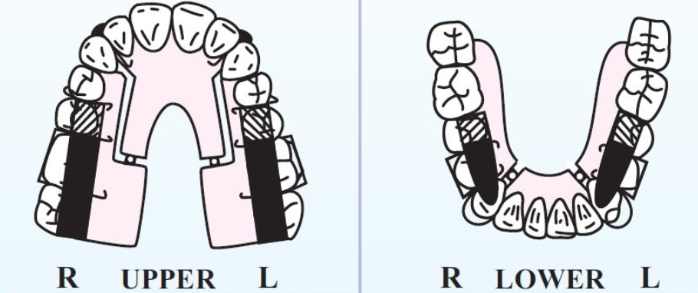
TYPE-5

Slide 19
TYPE-6

Slide 20
INDICATIONS:
The basic indication is Class-II div- 1 malocclusion. The following is a good selection criteria:- - Permanent dentition and active grower. - Uncrowded dentition with well-developed arches. - 10mm or less overjet with normal to deep overbite. - Improved facial aesthetics once the mandible is brought forward to class-I. - Normal growth direction .

Slide 21
INDICATIONS:
To treat other types of malocclusion:- - Class-II div-2. - Class I open bite. - Class-III - Lateral constriction of the arch. - Anterior/ Posterior arch length discrepancies.
TMJ therapy

Slide 22
INDICATIONS:
Two separate upper and lower appliances work together as one. - Interlock at 70 degree angle. - Set into the bite block. - Posture the mandible forward into ideal class-1 position preset by wax registration.
Frees locked-in lower jaw, encourages it to grow to its fullest potential.
Can be used on people of all ages but usually used on growing patients to treat an underdeveloped lower jaw.

Slide 23
TREATMENT STAGE:- ‘2 STAGE TREATMENT’:
Active Phase- Twin block: - Reposition the mandible forward until overjet and overbite are corrected. - First molar will be in contact - Maxillary and mandibular incisors will be nicely coupled. - Worn a minimum of 7 to 9 months to prevent development of dual bite

Slide 24
Support Phase- Retainer or Fixed Appliance - URA with steep anterior inclined plane is used to retain the corrected incisors relation until posterior occlusion is fully integrated - Usually takes 4-6 months and is continued for additional 3-6 months to allow the re-orientation of muscular complex.

Slide 25
SUMMARY
The functional mechanism is very similar to that of the natural dentition.
The occlusal inclined planes give greater freedom of movement in lateral and anterior excursion and cause less interference with normal function.
Less bulk, therefore, better patient compliance.
Can be used in later stages of growth (late mixed dentition/early permanent dentition)
The appliance can be cemented in mouth, without disrupting the normal oral functions, to improve patient compliance.
Absence of lip pads and buccal shields, allow patient a much better comfort, however, modifications containing lip pads can be incorporated as and when required.

Slide 26
REFERENCES
Textbook of Orthodontics – Gurkeerat Singh, Jaypee Brothers; 2nd Edition
Orthodontics – The Art and Science, S.I Bhalajhi, AryaMedi Publishing; 7th Edition
Textbook of Orthodontics – Sridhar Premkumar, Elsevier; 1st Edition
Orthodontics: Diagnosis and Management of Malocclusion and Dentofacial Deformities – O.P Kharbanda, Elsevier; 1st Edition

Slide 27
Question & Answer Session

